Slide 1

Open science: making data and code open, accessible, and reproducible.
```{r, presentation info, echo = T}
author = "Ryan Eckert"
date = as.Date("04/10/2020", "%m/%d/%y")
cat(paste(author, date, sep = "/n"))
```
Ryan Eckert
2020-04-10

Slide 2
Goals.
We want:
to work on our code in a way that is version controlled and easily communicable

Slide 3
Goals.
We want:
to work on our code in a way that is version controlled and easily communicable
an effective way to share data and code

Slide 4
Goals.
We want:
to work on our code in a way that is version controlled and easily communicable
an effective way to share data and code
to make our code easily reproducible

Slide 5
Goals.
We want:
to work on our code in a way that is version controlled and easily communicable
an effective way to share data and code
to make our code easily reproducible
to archive our data and code so that it is always accessible and citable

Slide 6


Goals.
This allows transparency in our research and is helpful to others who are developing skillsets

Slide 7
Goals.
This allows transparency in our research and is helpful to others who are developing skillsets
We can accomplish all these goals effectively using free platforms: Rmarkdown, GitHub, and Zenodo

Slide 8
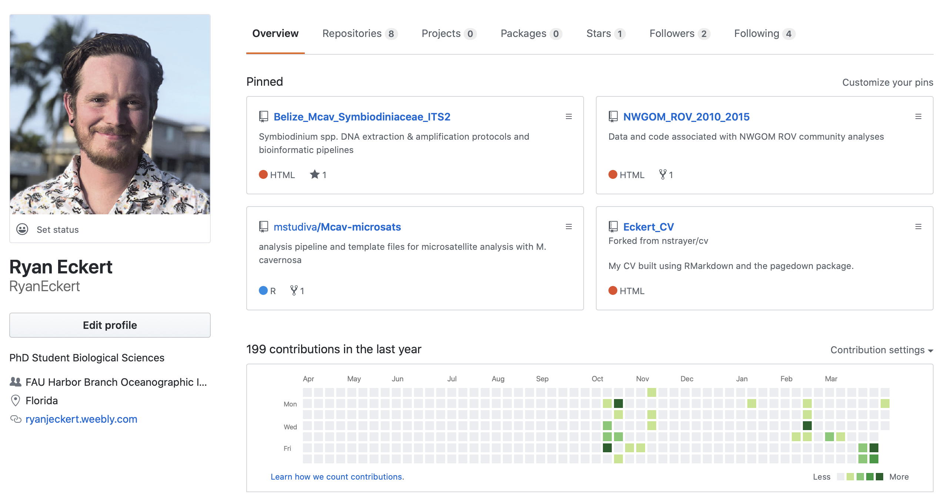
GitHub.
Development platform

Slide 9
GitHub.
Development platform
Site to host and review code

Slide 10
GitHub.
Development platform
Site to host and review code
A way to collaborate on programs/projects

Slide 11
GitHub.
Development platform
Site to host and review code
A way to collaborate on programs/projects
Fork repositories of interest

Slide 12
GitHub.
Development platform
Site to host and review code
A way to collaborate on programs/projects
Fork repositories of interest
Clone repositories from others

Slide 13
GitHub.
Development platform
Site to host and review code
A way to collaborate on programs/projects
Fork repositories of interest
Clone repositories from others
Version control system (VCS)

Slide 14
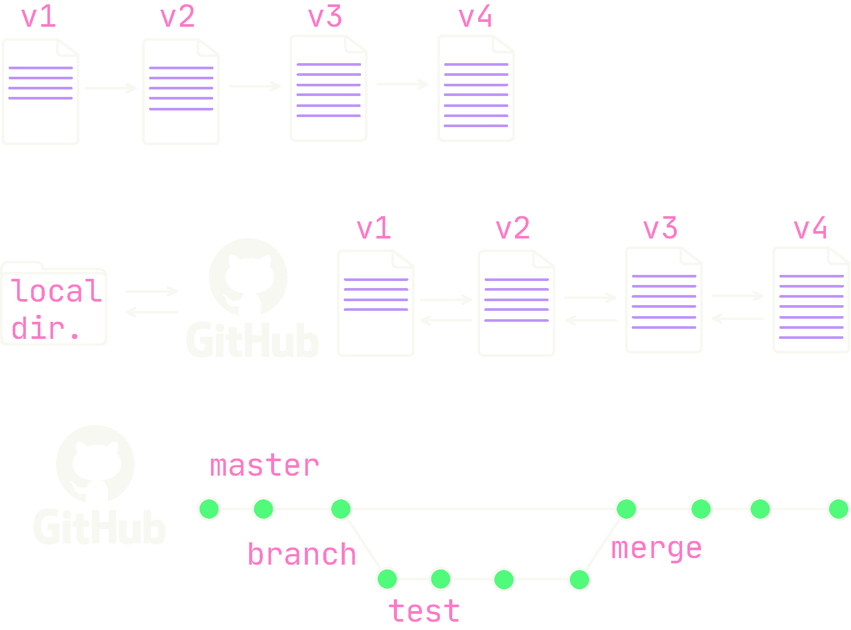
GitHub.
Working locally on code is often destructive—versions replace one another

Slide 15
GitHub.
Working locally on code is often destructive—versions replace one another
Using GitHub allows us to easily implement version control—changes are documented between versions *This depends on how often you commit to GitHub*
Additionally, we can branch to work on issues away from the master experimentally. If we are happy with changes we can merge this branch back to the master

Slide 16
GitHub.
Working locally on code is often destructive—versions replace one another
Using GitHub allows us to easily implement version control—changes are documented between versions *This depends on how often you commit to GitHub*
Additionally, we can branch to work on issues away from the master experimentally. If we are happy with changes we can merge this branch back to the master

Slide 17
GitHub.
Working locally on code is often destructive—versions replace one another
Using GitHub allows us to easily implement version control—changes are documented between versions *This depends on how often you commit to GitHub*
Additionally, we can branch to work on issues away from the master experimentally. If we are happy with changes we can merge this branch back to the master

Slide 18
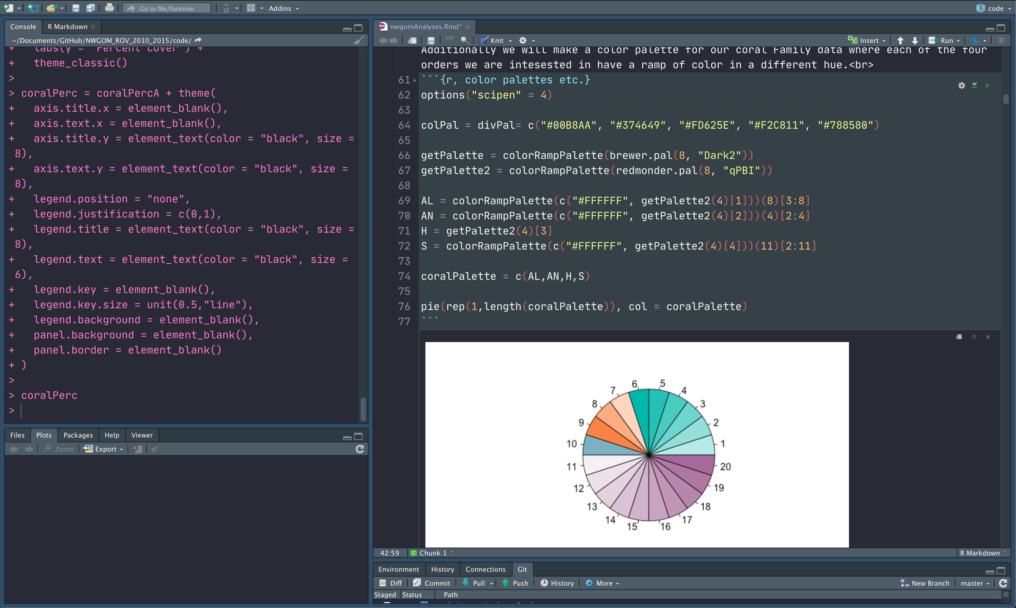
Rmarkdown.
Notebook interface

Slide 19
Rmarkdown.
Notebook interface
Create dynamic documents
Create websites, CVs, books, articles, presentations, etc.

Slide 20
Rmarkdown.
Notebook interface
Create dynamic documents
Create websites, CVs, books, articles, presentations, etc.

Slide 21
Rmarkdown.
Three main components:
YAML header
Set options
Body text
Html, markdown, plain text
Code Chunks
Specify language and options for knitting

Slide 22
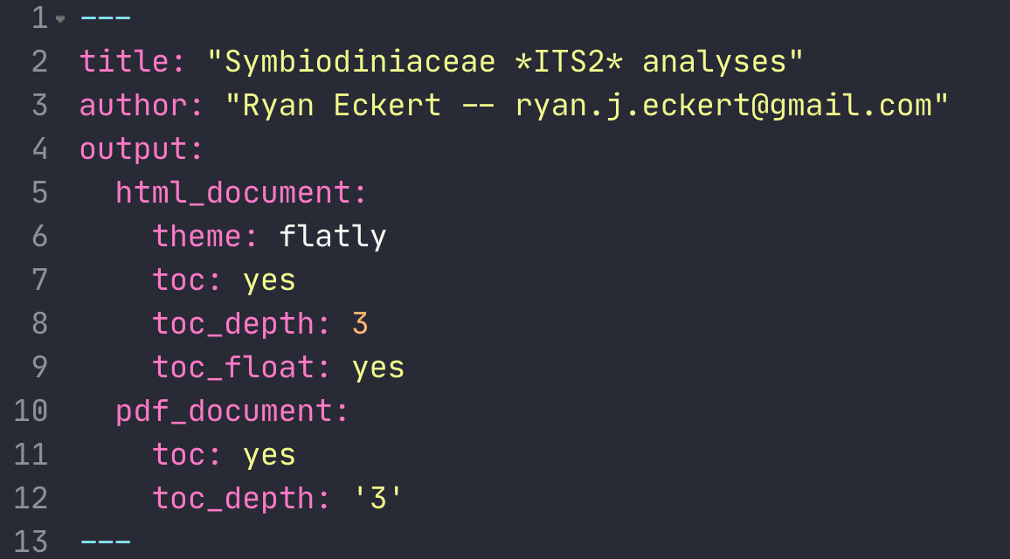
Rmarkdown.
Three main components:
YAML header
Set options
Body text
Html, markdown, plain text
Code Chunks
Specify language and options for knitting

Slide 23
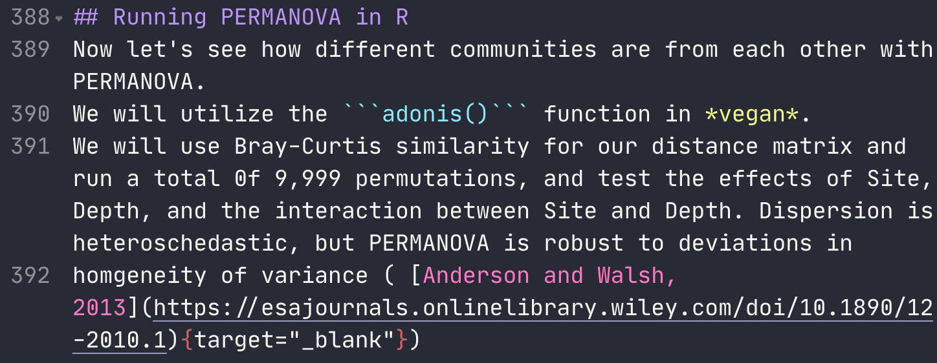
Rmarkdown.
Three main components:
YAML header
Set options
Body text
Html, markdown, plain text
Code Chunks
Specify language and options for knitting

Slide 24
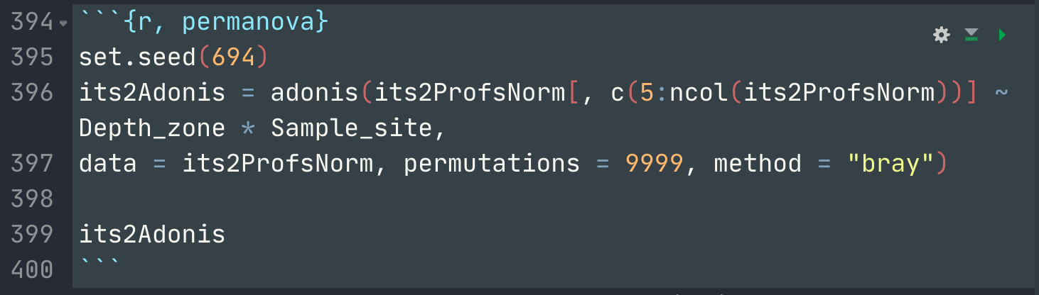
Rmarkdown.
Three main components:
YAML header
Set options
Body text
Html, markdown, plain text
Code Chunks
Specify language and options for knitting

Slide 25
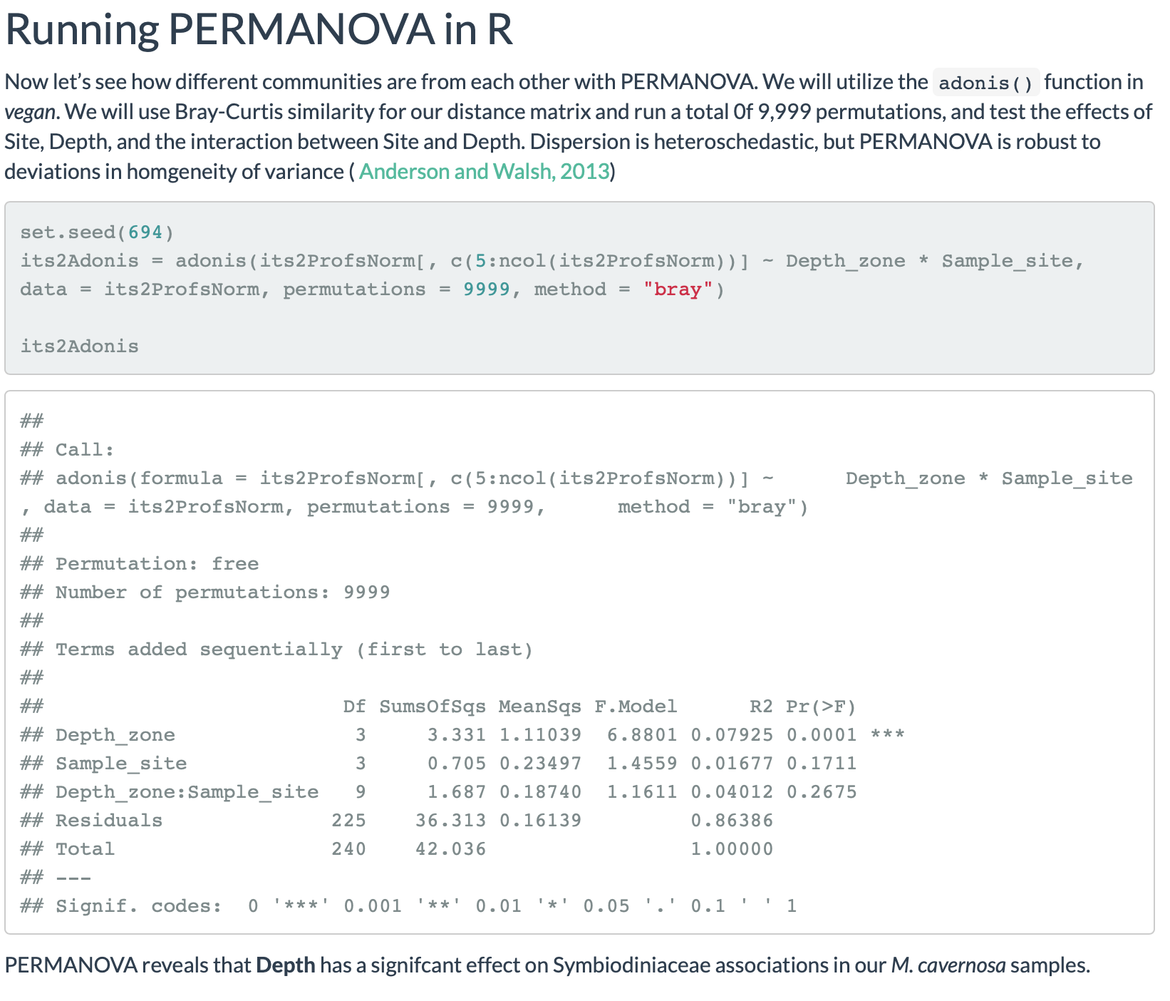
Rmarkdown.
Knit to a document
.html; .pdf; .docx & more

Slide 26
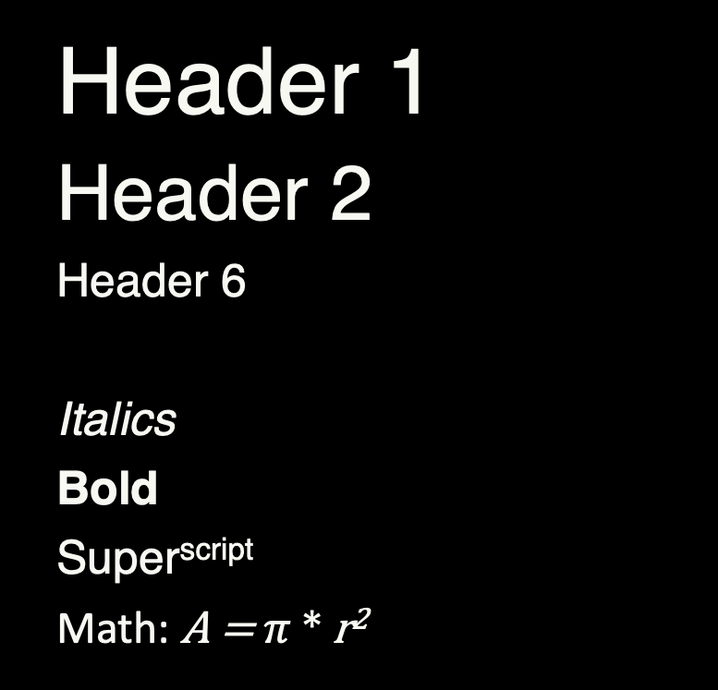
Rmarkdown quick cheat sheet.
Header 1
Header 2
Header 6
Italics
Bold
Super^{script}
Math: A = $π$ * r²
# Header 1
## Header 2
###### Header 6
***
*Italics*
**Bold**
Super^script^
Math: $A = \pi*r^{2}$

Slide 27
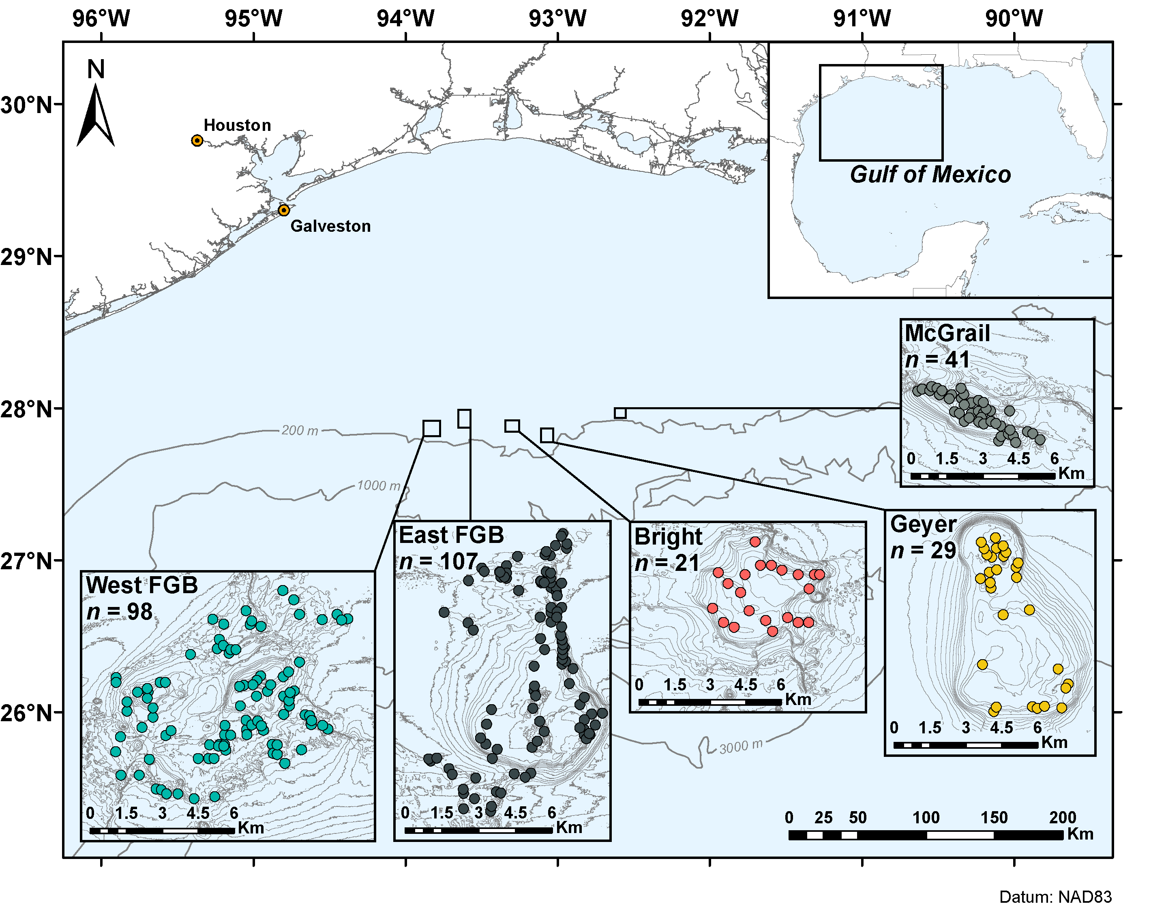
Rmarkdown quick cheat sheet.
* Unordered
* list
+ with bullets
1. Ordered
2. list
+ with numbers
![Figure 1](path/to/image.png)
Unordered
list
with bullets
Ordered
list
with numbers

Slide 28
Rmarkdown quick cheat sheet.
```{language, name, parameters}
Code chunk
```
print code `inline`
`r paste("run code inline")`
[Hyperlink](https://ryanjeckert.weebly.com){target=“_blank”}
```{language, name, parameters}
Code chunk
```
Print code inline
run code inline
Hyperlink

Slide 29
Zenodo.
Open-access repository

Slide 30
Zenodo.
Open-access repository
Can permanently archive data, metadata, and code

Slide 31
Zenodo.
Open-access repository
Can permanently archive data, metadata, and code
Link to GitHub repo and create a DOI

Slide 32
Zenodo.
Log in to Zenodo (zenodo.org) with GitHub account

Slide 33
Zenodo.
Log in to Zenodo (zenodo.org) with GitHub account
Authorize application: Zenodo

Slide 34
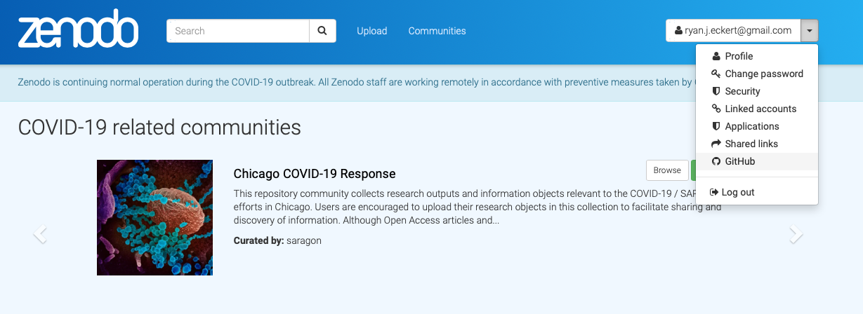
Zenodo.
Log in to Zenodo (zenodo.org) with GitHub account
Authorize application: Zenodo
Go to GitHub tab in Zenodo

Slide 35
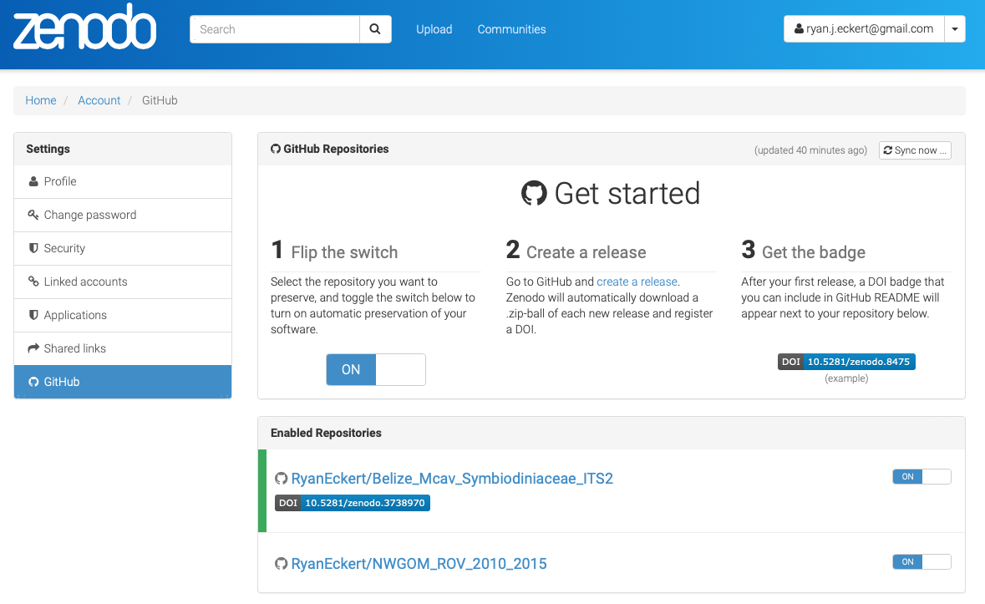
Zenodo.
Log in to Zenodo (zenodo.org) with GitHub account
Authorize application: Zenodo
Go to GitHub tab in Zenodo
Toggle switch to “ON” for selected repo

Slide 36
Zenodo.
Log in to Zenodo (zenodo.org) with GitHub account
Authorize application: Zenodo
Go to GitHub tab in Zenodo
Toggle switch to “ON” for selected repo

Slide 37
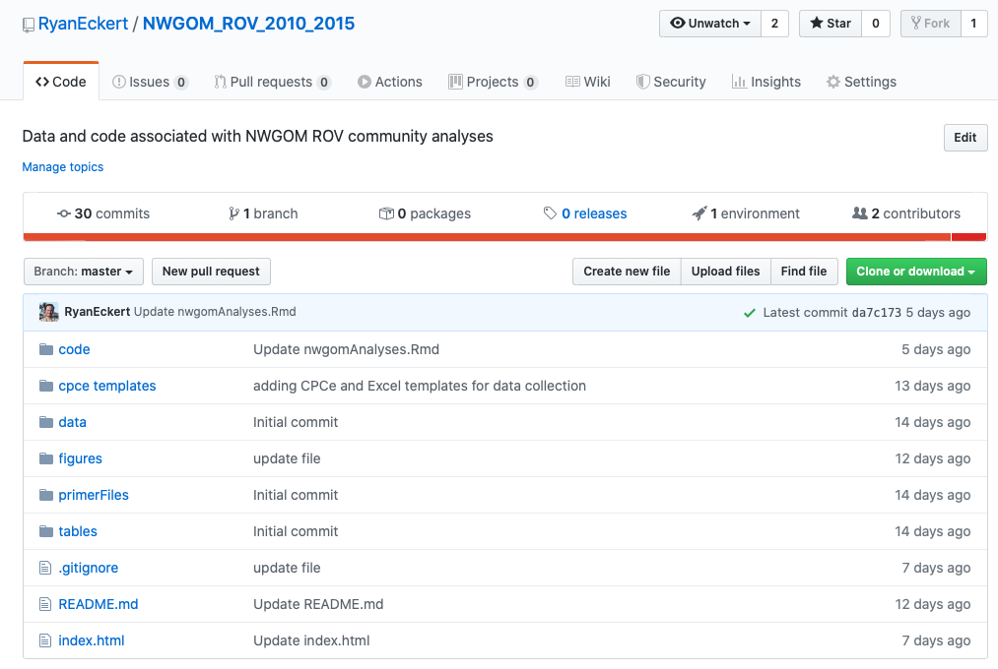
Zenodo.
Log in to Zenodo (zenodo.org) with GitHub account
Authorize application: Zenodo
Go to GitHub tab in Zenodo
Toggle switch to “ON” for selected repo
Create a release on GitHub

Slide 38
Zenodo.
Log in to Zenodo (zenodo.org) with GitHub account
Authorize application: Zenodo
Go to GitHub tab in Zenodo
Toggle switch to “ON” for selected repo
Create a release on GitHub

Slide 39
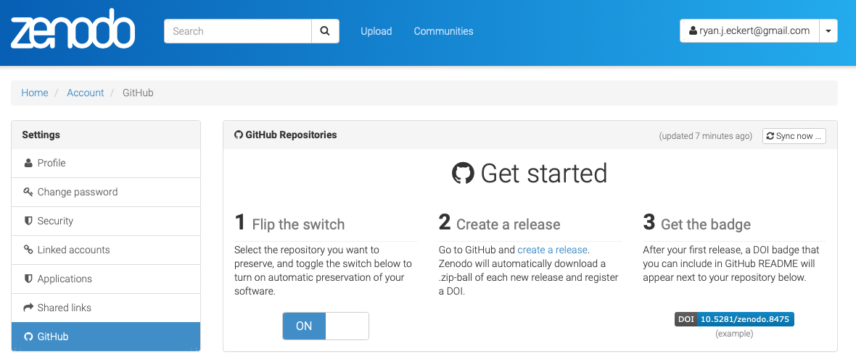
Zenodo.
Log in to Zenodo (zenodo.org) with GitHub account
Authorize application: Zenodo
Go to GitHub tab in Zenodo
Toggle switch to “ON” for selected repo
Create a release on GitHub
Complete info for release on Zenodo under upload

Slide 40
Zenodo.
Log in to Zenodo (zenodo.org) with GitHub account
Authorize application: Zenodo
Go to GitHub tab in Zenodo
Toggle switch to “ON” for selected repo
Create a release on GitHub
Complete info for release on Zenodo under upload

Slide 41
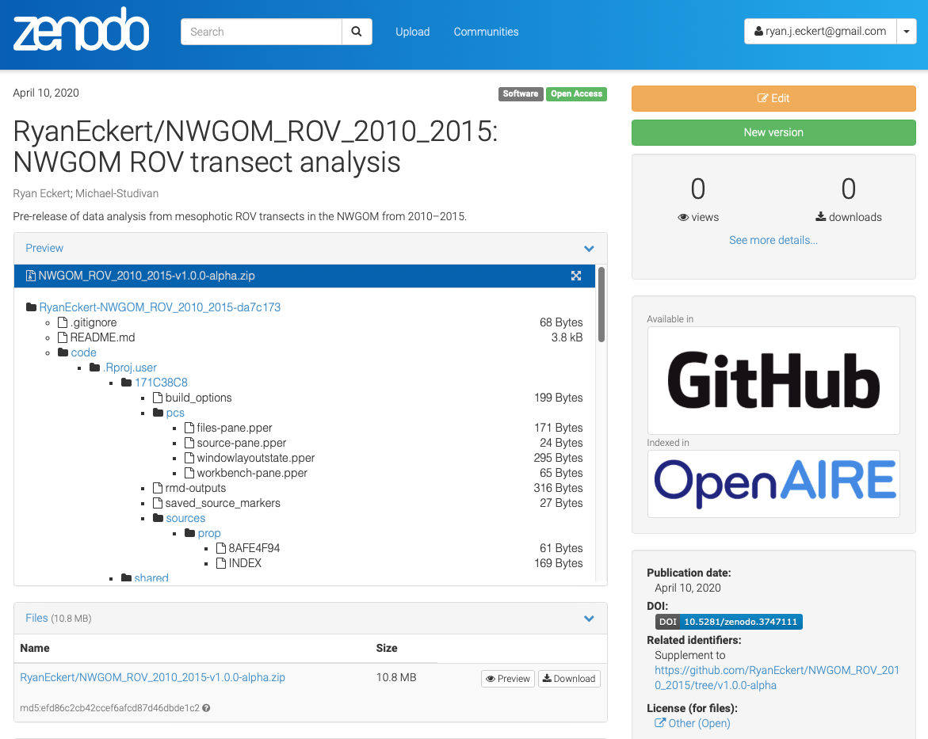
Zenodo.
Log in to Zenodo (zenodo.org) with GitHub account
Authorize application: Zenodo
Go to GitHub tab in Zenodo
Toggle switch to “ON” for selected repo
Create a release on GitHub
Complete info for release on Zenodo under upload

Slide 42
Zenodo.
Log in to Zenodo (zenodo.org) with GitHub account
Authorize application: Zenodo
Go to GitHub tab in Zenodo
Toggle switch to “ON” for selected repo
Create a release on GitHub
Complete info for release on Zenodo under upload

Slide 43
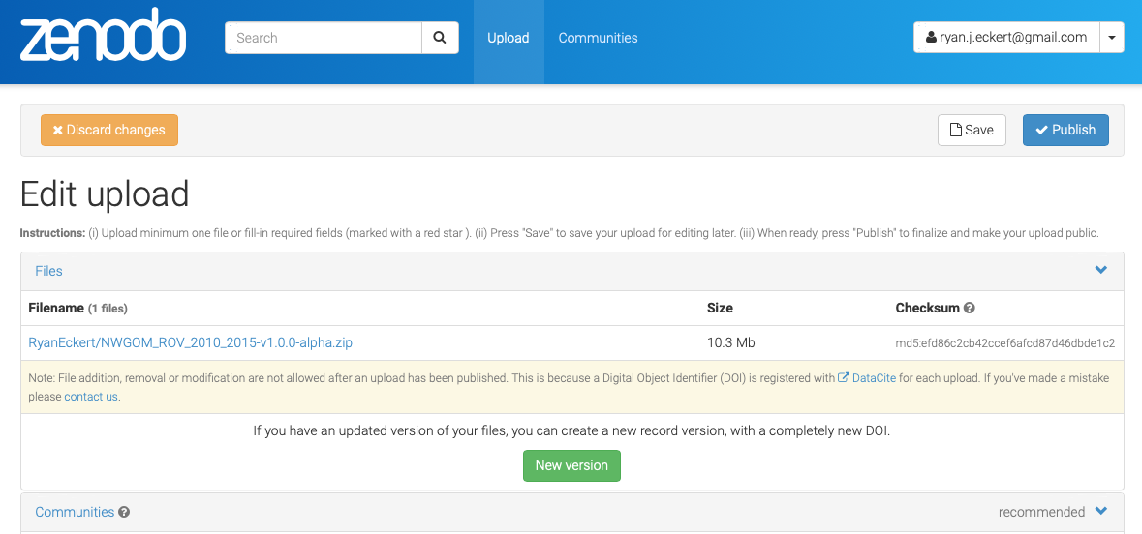
Zenodo.
Log in to Zenodo (zenodo.org) with GitHub account
Authorize application: Zenodo
Go to GitHub tab in Zenodo
Toggle switch to “ON” for selected repo
Create a release on GitHub
Complete info for release on Zenodo under upload
Save edits and publish

Slide 44
Zenodo.
Log in to Zenodo (zenodo.org) with GitHub account
Authorize application: Zenodo
Go to GitHub tab in Zenodo
Toggle switch to “ON” for selected repo
Create a release on GitHub
Complete info for release on Zenodo under upload
Save edits and publish

Slide 45
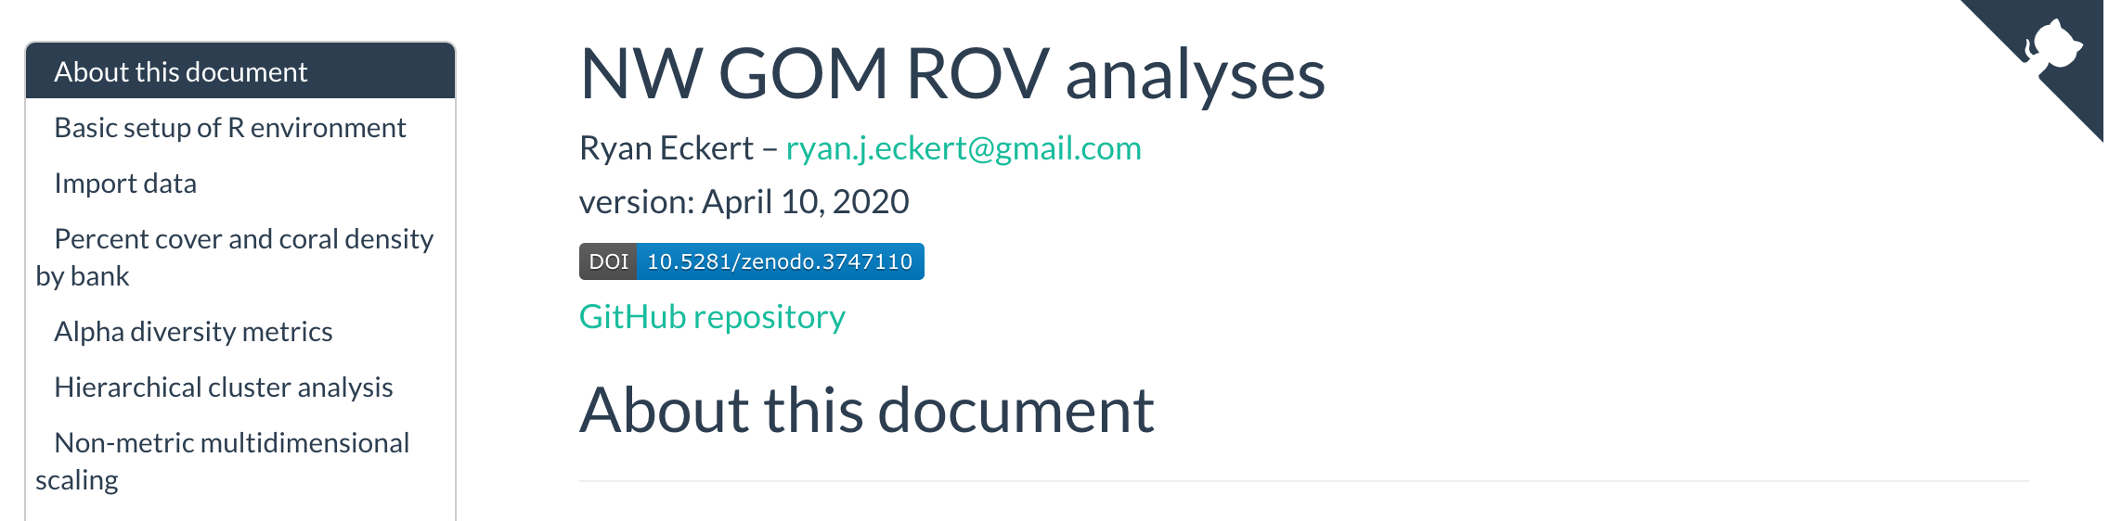
Zenodo.
Now you should see a DOI badge on Zenodo

Slide 46
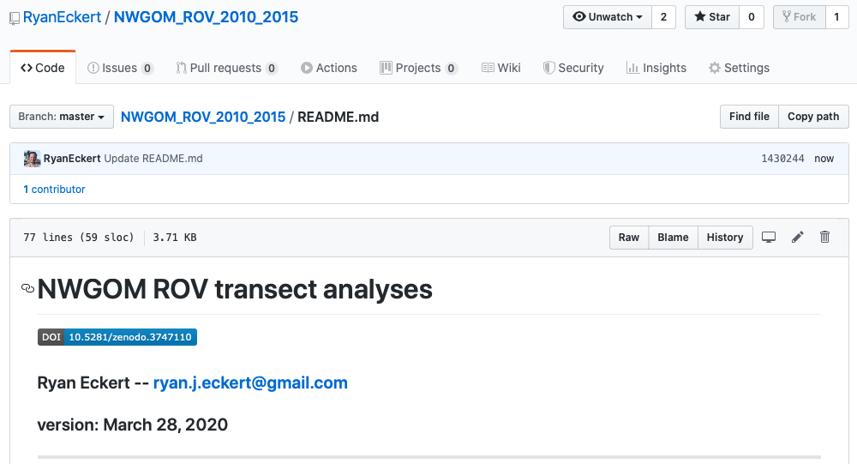
Zenodo.
Now you should see a DOI badge on Zenodo
Since we know how to write markdown we can include the DOI badge on our GitHub and in our Rmarkdown documents.

Slide 47

Zenodo.
Now you should see a DOI badge on Zenodo
Since we know how to write markdown we can include the DOI badge on our GitHub and in our Rmarkdown documents.

Slide 48
Programs & packages.
Rstudio (https://rstudio.com/products/rstudio/download/)

Slide 49

Programs & packages.
Rstudio (https://rstudio.com/products/rstudio/download/)
rmarkdown ( install.packages("rmarkdown") )

Slide 50
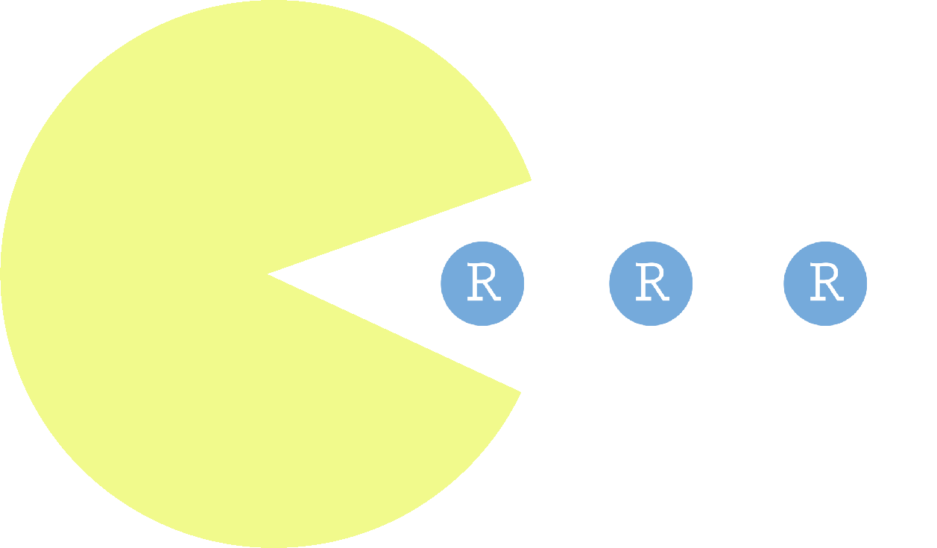
Programs & packages.
Rstudio (https://rstudio.com/products/rstudio/download/)
rmarkdown ( install.packages("rmarkdown") )
pacman ( install.packages("pacman") )

Slide 51

Programs & packages.
Rstudio (https://rstudio.com/products/rstudio/download/)
rmarkdown ( install.packages("rmarkdown") )
pacman ( install.packages("pacman") )
tidyverse ( install.packages("tidyverse") )

Slide 52

Programs & packages.
patchwork ( (install.packages("patchwork") )

Slide 53

Programs & packages.
patchwork ( (install.packages("patchwork") )
GitHub Desktop (https://desktop.github.com)

Slide 54

Programs & packages.
patchwork ( (install.packages("patchwork") )
GitHub Desktop (https://desktop.github.com)
Atom (https://atom.io/download/)

Slide 55
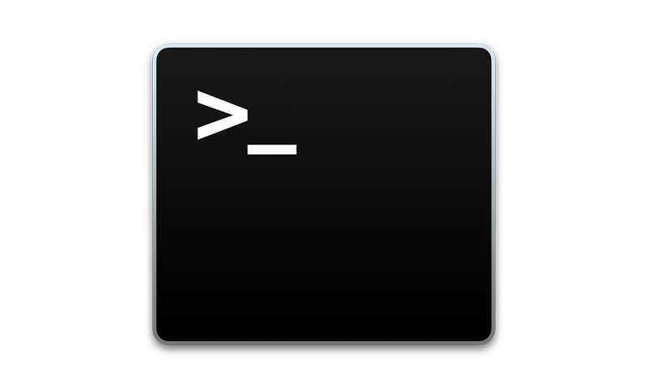
Programs & packages.
patchwork ( (install.packages("patchwork") )
GitHub Desktop (https://desktop.github.com)
Atom (https://atom.io/download/)
Terminal (Mac)

Slide 56
Best practices/recommendations.
Initialize a GitHub repo for data analysis

Slide 57
Best practices/recommendations.
Initialize a GitHub repo for data analysis
Create an R project file for new repo (.Rproj)

Slide 58
Best practices/recommendations.
Initialize a GitHub repo for data analysis
Create an R project file for new repo (.Rproj)
START writing code in Rmarkdown

Slide 59
Best practices/recommendations.
Initialize a GitHub repo for data analysis
Create an R project file for new repo (.Rproj)
START writing code in Rmarkdown
Spend time upfront creating publishable figures

Slide 60
Best practices/recommendations.
Commit to GitHub often while working to maintain good VC

Slide 61
Best practices/recommendations.
Commit to GitHub often while working to maintain good VC
Submit raw sequences to NCBI SRA (or equivalent)

Slide 62
Best practices/recommendations.
Commit to GitHub often while working to maintain good VC
Submit raw sequences to NCBI SRA (or equivalent)
When publishing, create a Zenodo archive for GitHub repo and create DOI

Slide 63
Tips & tricks.
Look at GitHub repos/code from papers with analyses/plots you want to use

Slide 64
Tips & tricks.
Look at GitHub repos/code from papers with analyses/plots you want to use
Stackoverflow.com

Slide 65
Tips & tricks.
Look at GitHub repos/code from papers with analyses/plots you want to use
Stackoverflow.com
Use tidyverse for data manipulation/plotting and patchwork for multi-panel figures

Slide 66
Tips & tricks.
Look at GitHub repos/code from papers with analyses/plots you want to use
Stackoverflow.com
Use tidyverse for data manipulation/plotting and patchwork for multi-panel figures
Color palettes: paletteer ( install.packages("paletteer") ); create your own with: colorRampPalette()

Slide 67

Tips & tricks.
Use dark themes in Terminal, Atom, Rstudio, etc. to reduce eye strain/fatigue (I like Dracula or SMYCK)

Slide 68
Tips & tricks.
Use dark themes in Terminal, Atom, Rstudio, etc. to reduce eye strain/fatigue (I like Dracula or SMYCK)
Change font to help with readability
(I prefer JetBrains Mono)

Slide 69
Tips & tricks.
Use dark themes in Terminal, Atom, Rstudio, etc. to reduce eye strain/fatigue (I like Dracula or SMYCK)
Change font to help with readability
(I prefer JetBrains Mono)
Keep everything CONSISTENT and UNIQUE
No variables with the same name over and over (i.e. df, plot)

Slide 70
Tips & tricks.
I use caterpillarCase for variables and objects
thisMakesItEasierToRead (for me)
I_prefer_it_over_all_these_damn_underscores-or-hyphens

Slide 71
Tips & tricks.
I use caterpillarCase for variables and objects
thisMakesItEasierToRead (for me)
I_prefer_it_over_all_these_damn_underscores-or-hyphens
Keep variables and objects short when possible
northwestGulfOfMexicoRovOnlyCoralSpecies = read.csv("nwgomCoral.csv")
nwgomCoral = read.csv("nwgomCoral.csv")

Slide 72
Tips & tricks.
I use caterpillarCase for variables and objects
thisMakesItEasierToRead (for me)
I_prefer_it_over_all_these_damn_underscores-or-hyphens
Keep variables and objects short when possible
northwestGulfOfMexicoRovOnlyCoralSpecies = read.csv("nwgomCoral.csv")
nwgomCoral = read.csv("nwgomCoral.csv")
I keep spaces in my code when allowed/optional (e.g. R)
This = much(easier = "on the eyes", in my opinion)
This=becomes(very="tedious",to,read,over=time)

Slide 73

There is not one right way.
This is typically how I do things.

Slide 74
There is not one right way.
This is typically how I do things.
I have found that this workflow works well for me.

Slide 75
There is not one right way.
This is typically how I do things.
I have found that this workflow works well for me.
Ultimately, these are guidelines to help introduce ways to work effectively and commit to open science.

Slide 76
There is not one right way.
This is typically how I do things.
I have found that this workflow works well for me.
Ultimately, these are guidelines to help introduce ways to work effectively and commit to open science.
Take these ideas and implement a system that works well for you.

Slide 77

There is not one right way.
This is typically how I do things.
I have found that this workflow works well for me.
Ultimately, these are guidelines to help introduce ways to work effectively and commit to open science.
Take these ideas and implement a system that works well for you.
Freak what you feel.

